Slide 1
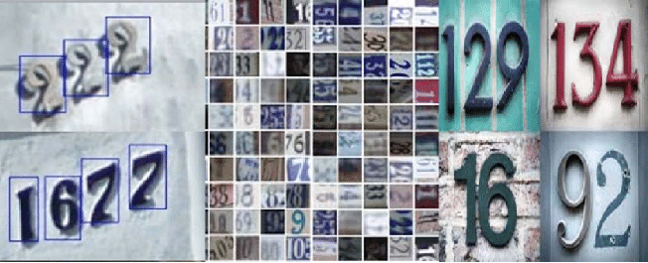
Computer Vision Digit Recognition
Julian Sneve
Springboard Data Science Capstone Project
https://github.com/jabsneve/hurricanes_capstone

Slide 2
The Goal
Create a computer vision model

Slide 3

The Data
Street View Housing Numbers (SVHN)
Contains over 600,000 images cropped from Google Street View
Maintained by Stanford University

Slide 4
The Data x 2
Dataset 1
Dataset 2
Original images
MATLAB (.mat) files
Dictionary-type format
Three features
Images
Bounding box dimensions
Labels
Cropped images
csv files
Two features
Pixel values
Labels

Slide 5

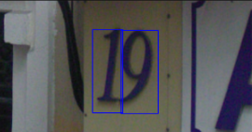
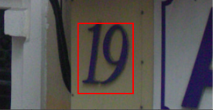
Data Pre-processing
Extract and concatenate data to produce images with bounding boxes
Merge bounding boxes
Crop based on bounding boxes

Slide 6
Data Pre-processing
Convert pixel values to arrays
Combine image labels and pixel arrays into a dataframe
Save as csv

Slide 7

Model Development
Convolution Neural Network (CNN)
Keras functional API
Flexible functionality
TensorFlow backend

Slide 8
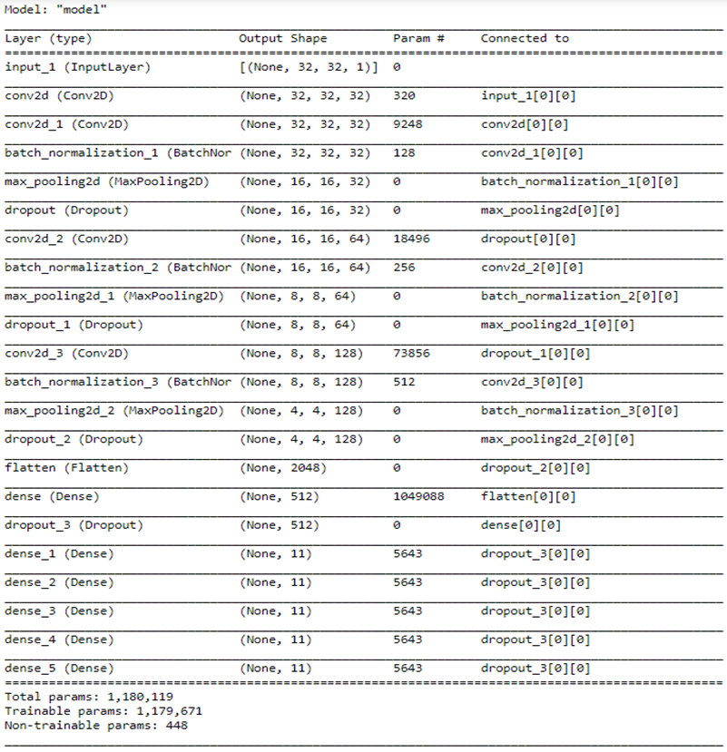
Final Model
Five layers
Input
2D Convolutional
2D Convolutional
2D Convolutional
Output
Total parameters:
1,180,119
Trainable parameters:
1,179,671

Slide 9
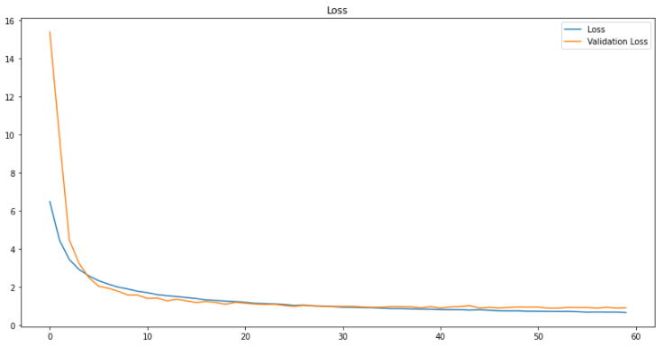
Model Training
Earlystopping callback halted training after 59 epochs
Validation loss had ceased improving

Slide 10
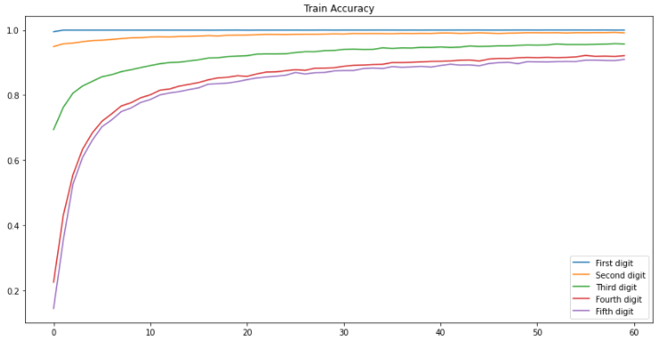
Model Training

Slide 11
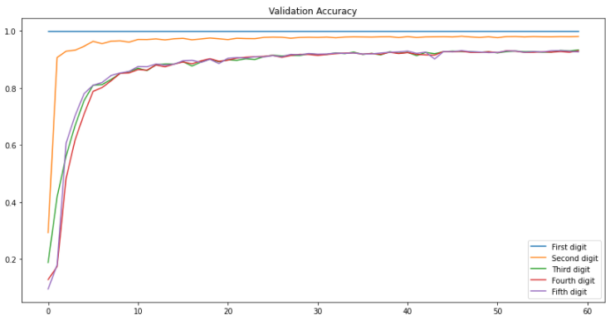
Model Training

Slide 12
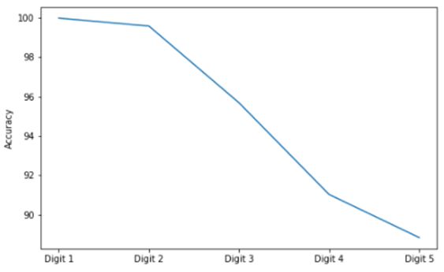
Model Performance
Unseen test data
Accuracy by digit:
1 – 99.98%
2 – 99.58%
3 – 95.68%
4 – 91.02%
5 – 88.83%
Overall accuracy: 95.02%

Slide 13
Future Improvements
Investigate why the accuracy drops off for higher digits
Utilize a YOLO CNN to create a less robust image recognition process while increasing accuracy

Slide 14
Thank You
Julian Sneve
Email: jack.sneve@gmail.com
Github: https://github.com/jabsneve
Dataset credit: http://ufldl.stanford.edu/housenumbers/

